Slide 1


Trustee Boundary Maps
Sundale Union Elementary School District
Presented by Ken Reynolds
President, SchoolWorks, Inc.

Slide 2


INTRODUCTION
This presentation illustrates options for the District to re-balance the population for each of the trustee areas..
The general guidelines for drawing trustee boundaries include:
  Topography & Geography
  Communities
  Cohesiveness & Contiguous
  Location of Current Trustees
  Equal Population
For each scenario, there are maps showing the boundaries for each trustee area, a table showing the population in each trustee area and the variance from the ideal population. The peak deviation must be less than 10% for the maps to meet the legal requirements. Finally, details of the racial/ethnic populations are provided.
2

Slide 3
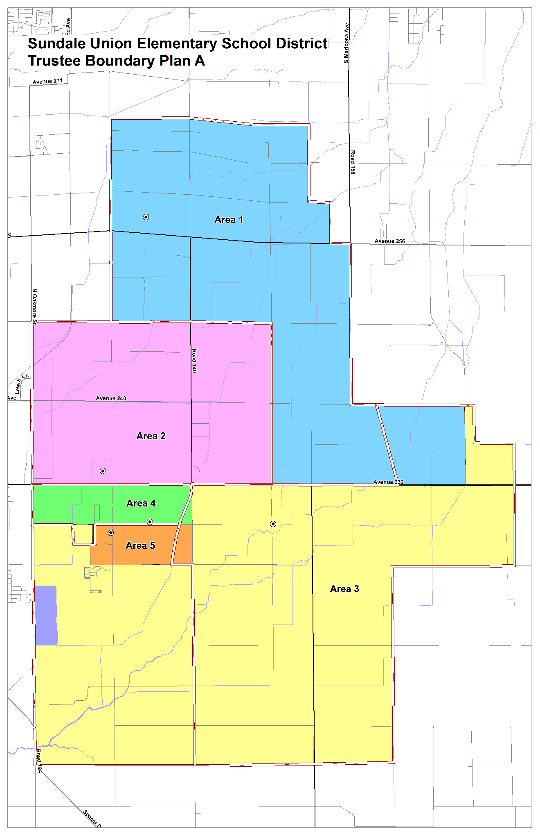
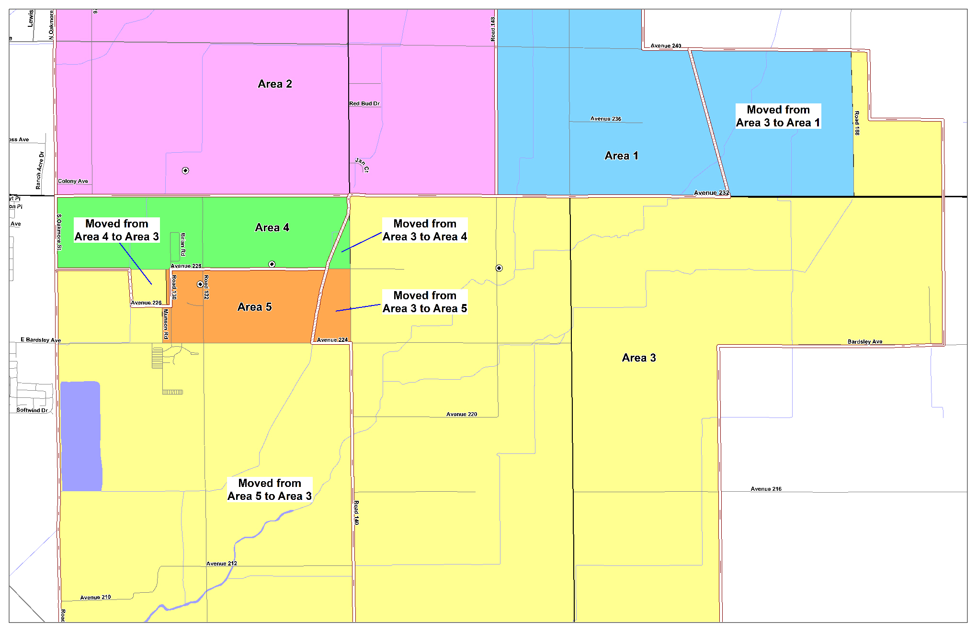
Trustee Area Boundary Map A
3

Slide 4
Total Population and % Deviation, Map A
4

Slide 5
Demographics by Trustee Area, Map A
5

Slide 6
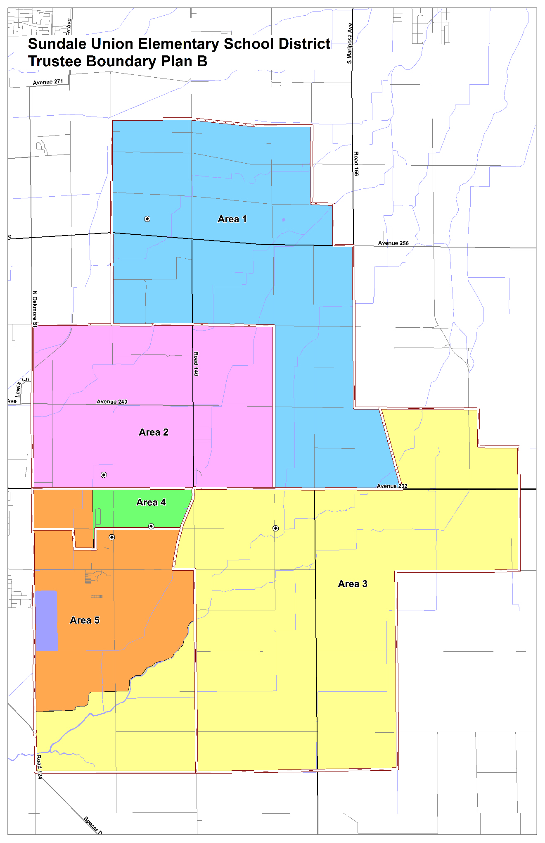
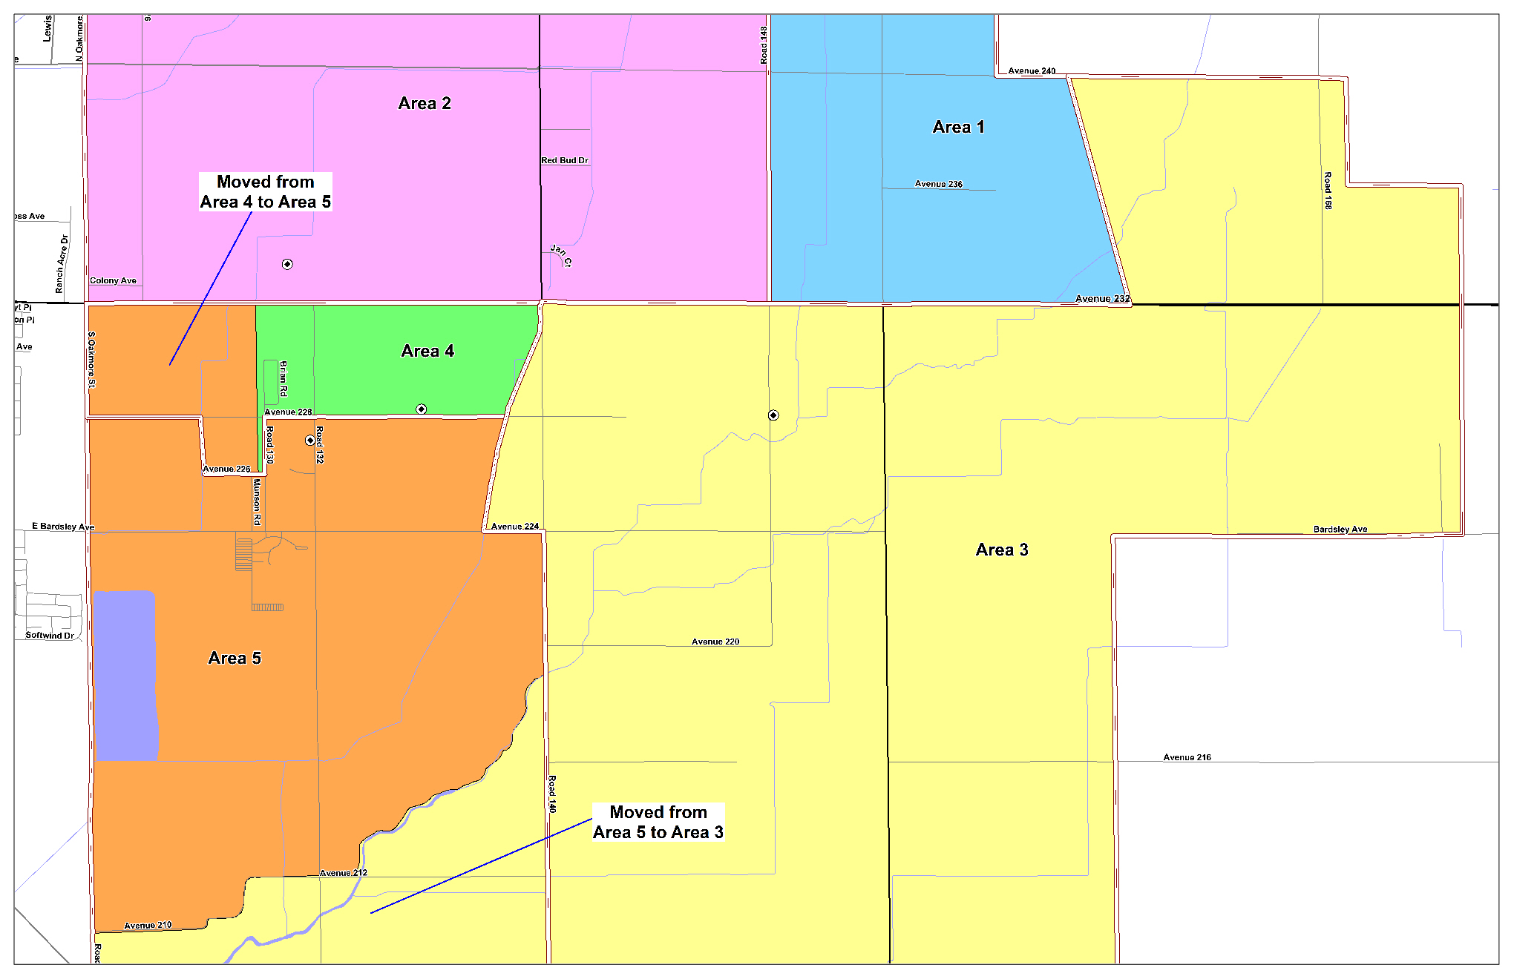
Trustee Area Boundary Map B
6

Slide 7
Total Population and % Deviation, Map B
7

Slide 8
Demographics by Trustee Area, Map B
8

Slide 9
CONCLUSION / NEXT STEPS
These Maps show possible solutions for the board to consider when complying with the requirement to re-district the trustee areas to balance the total population in each area.
Additional maps can be generated based on input from the board and community. A final decision to approve a boundary map needs to be completed by February 28th.
9

Slide 10
THANK YOU
Questions?
Input/Suggestions?
10

